Slide 1
technology architecture

Slide 2






Executive Summary
The WholeHealth project brings together researchers and clinicians with diverse backgrounds in computational-systems biology, computer science, mathematics, physics, psychology, medicine, and other disciplines to create a collaborative unified effort. Our primary mission is to develop a collaborative bigdata platform founded on the principles of systems biology to develop innovative low-cost sustainable preventive screening and treatments techniques from longitudinal patient samples/data collected over a period of 20-50 years.
Collaborators
Dallas VA
Medical Center
Funding

Slide 3
Example Techniques & Use Cases
Modern analytics is much more than just reporting & statistics… its actionable at the point-of-decision.
Descriptive Statistics
Compliance Reporting
Utilization & Outcomes
Aggregate Trends & Data Exploration
Inferential Statistics
Risk Stratification & Population Segmentation
Cost & Risk Forecasting
Treatment Efficacy
Configuration & Search
Identifying Gaps in Care
Avoiding Adverse Events
Personalized Care Plans & Recommendations
Signal Processing
Mobile Ambulatory Diagnostics (EKG, EEG, etc)
Tumor Screening & Analysis with Ultrasound
Muscle Rehab with EMG Signal Analysis
Path Analysis
Disease Networks & Characteristics
Treatment Optimization Graphs
Machine Learning & AI
Imaging Pattern Detection
Simulation & Modeling
Epigenetics Effects & Pathway Models
Modeling Epidemics

Slide 4








Unified Longitudinal Data Warehouse
The primary purpose of our research is to create a new path forward to integrate more robust preventive care into public health
Claims
Patients
Social Data
Clinical Events
Clinical Tests
Medicaid: ~2B
EMR: ~130M
Variables: ~20K
Total: 5.3B
Labs: 4.8B
Claims, Medical, SDOH & Environmental Longitudinal Data From 2000 - 2019

Slide 5

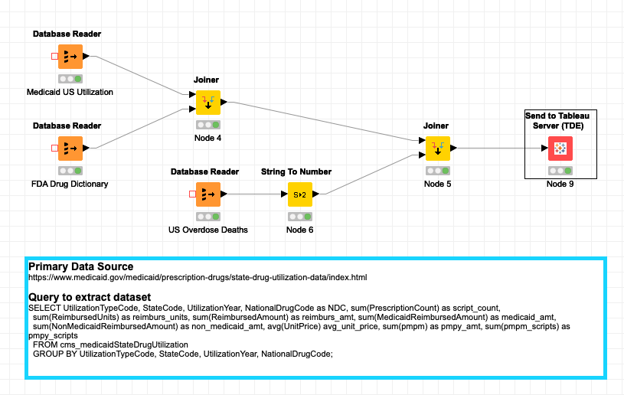





Integrated Modular Data Science Tools

Slide 6






Distributed Supercomputing
The primary purpose of our research is to create a new path forward to integrate more robust preventive care into public health
Behavioral
Health
Chronic Disease
Progression
Comet
Pytheas
Social
Determinants
Bioinformatics
Database
Social
Determinants
Clinical/Payer
Database
Preventive
Health
Healthcare
Economics
SDOH
Database
Dallas VA
Medical Ctr
Health
Policy
Infectious
Disease

Slide 7
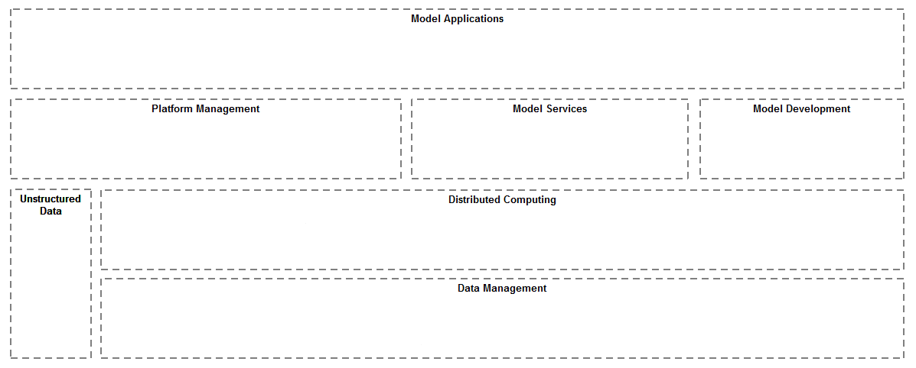


























CURRENT SOFTWARE TECHNOLOGY
Model Consumption, Analytics & Visualization
Model Languages
Model Workflow Management
Platform Management
Data Platform
High Performance Computing
Not supported on the basic desktop platform

